Slide 1
Business Letters

Slide 2
Objectives
What is a Business Letter
Types of Business Letters
Structure of the Letter
Format of letters
Block
Semi-block
Modified Block

Slide 3

What is a Business Letter
Formal message typically sent from one professional to another.
N.B. Business letters are not the same as Business emails.
Business letter is a printed letter delivered to the recipient’s desk or address.
This attribute is part of what makes business letters stand out from an email inquiry, which is why they tend to be used for important communications.
However, there are a few similarities between business letters and business emails. Both follow a similar format and end with a direct call to action

Slide 4
Types of Letters
Application for Employment/ Cover Letters
Sales Letters
Letters of Recommendation
Inquiry Letters
Offer & Appointment Letters
Resignation Letters
Request Letters
Complaint Letters
Invitation
Proposal

Slide 5
Business Letter Structure
Header: Date, address, return address
Salutation
Date of letter: especially impt for time-sensitive information
Return address: Include your company’s full address or your personal address. This makes it easy for the recipient to send a response.
Address: Write the recipient’s full address, including their PO Box number if applicable.
Standard salutation is “Dear.”
Begin your letter with “Dear [recipient’s name]” and add a comma or colon after the name.
When you cannot determine the recipient’s name, you may address the letter to their title or “Dear Sir/Madam”.

Slide 6
Business Letter Structure
Body
This is the bulk of a business letter. This section discusses the offer, proposition, or announcement the letter is making. It includes these sections:
An introductory paragraph that states the letter’s main purpose and, if necessary, introduces the letter writer.
One or more middle paragraphs that discuss the letter’s subject in greater detail.
A final paragraph that restates the letter’s purpose and offers an incentive, such as early bird pricing, for the recipient to follow up.
Closing
After the body section, close the letter with a simple, professional sign-off. Appropriate sign-offs include the following:
Sincerely
Respectfully
Signature
The final component of a business letter is your signature. Include your full name and any abbreviations that follow, such as BA, MBA or PhD.
Regards (primarily in emails)
This could be a job applicant’s relevant experience, the details of an offer, the repercussions of a policy change, or what the recipient can expect at the event to which they’re being invited.

Slide 7
Business Letter Format
Block Format
all the lines are left-justified, and there are no indents.
Semi-block format
Modified Block Format
all the lines are left-justified, and each paragraph is indented
the heading, closing, and signature are right-justified, while the body and addresses are left-justified. In this format, there are no indents

Slide 8
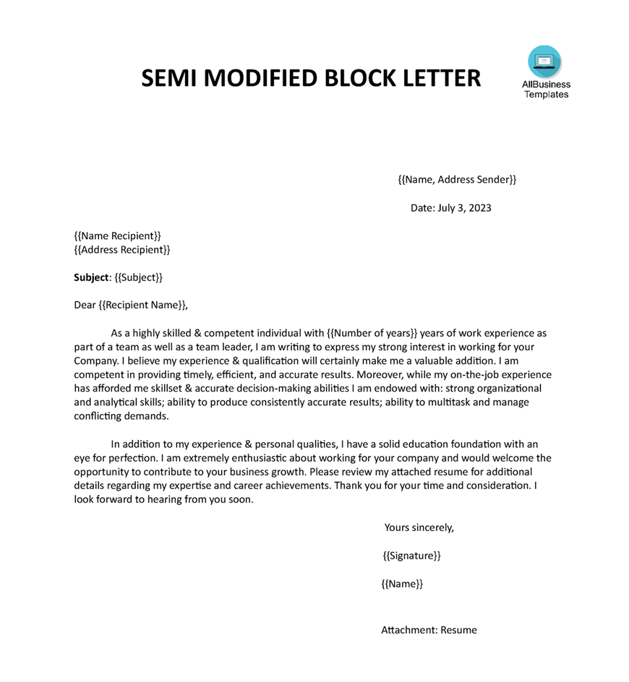
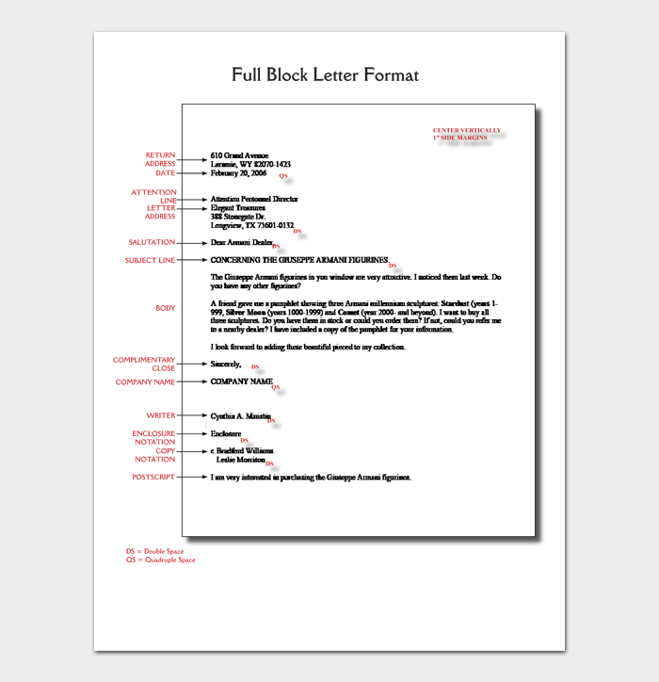

Slide 9
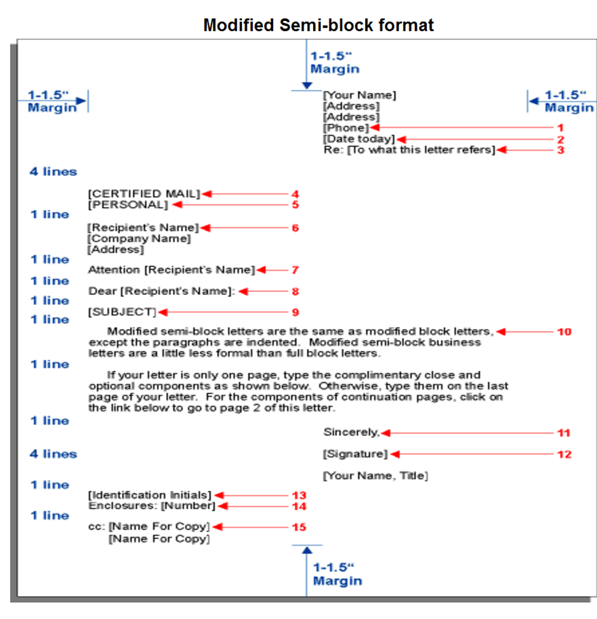

Slide 10
Mr. Steven Ramirez
Ink Company Name.
City, NY 10001
July 11, 2023
Mrs. Juliana McCue
Stationery Company Name
44 Example Way
City, CA 94024
Dear Mrs. McCue,
Let me take this opportunity to thank you for being such a loyal customer. Over the past five years, Stationery Company Name has been a top seller of Ink Company Name, and I speak for our entire team when I say we genuinely appreciate and value your partnership.
As a thank-you, I’d like to offer an exclusive collaboration opportunity: a fully customized hue exclusive to your retailer. Our team of experienced color specialists can develop any shade of the rainbow, from the darkest light-inhaling blacks to bright, reflective neons and iridescent inks.
Please let me know if you’d like to schedule a video call, during which I can explain our offer in greater detail and start exploring colors with you.
Sincerely,
Steven Ramirez

Slide 11
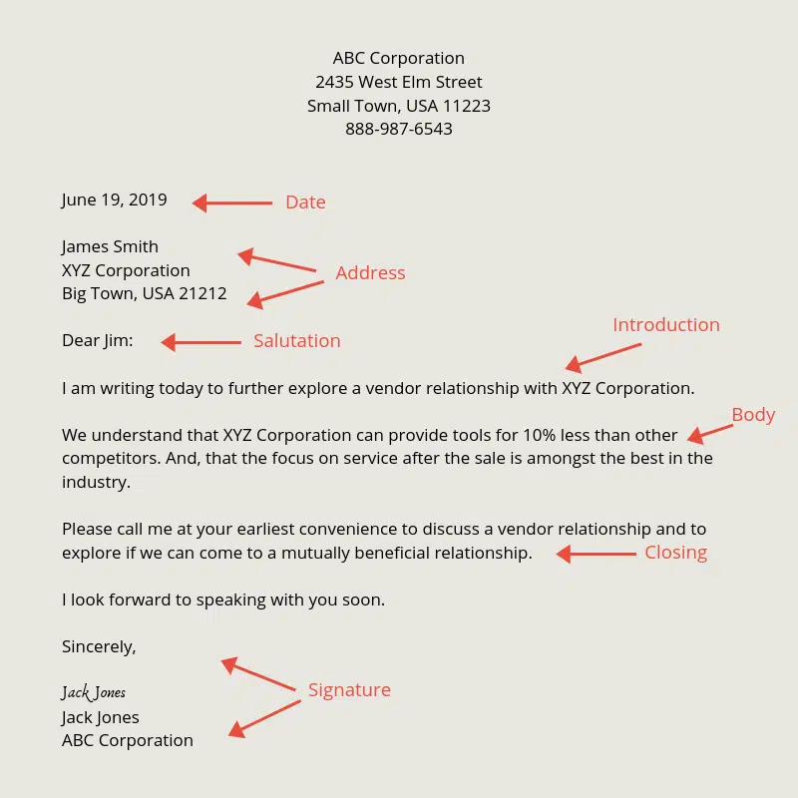

Slide 12
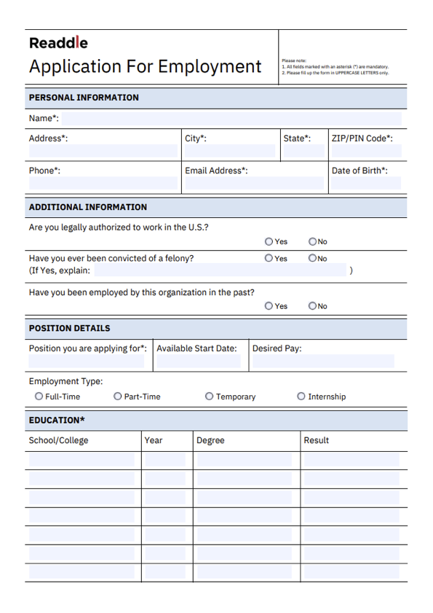

Slide 13
Application for Employment
Application for Employment forms
Application letter
Resumé

Slide 14
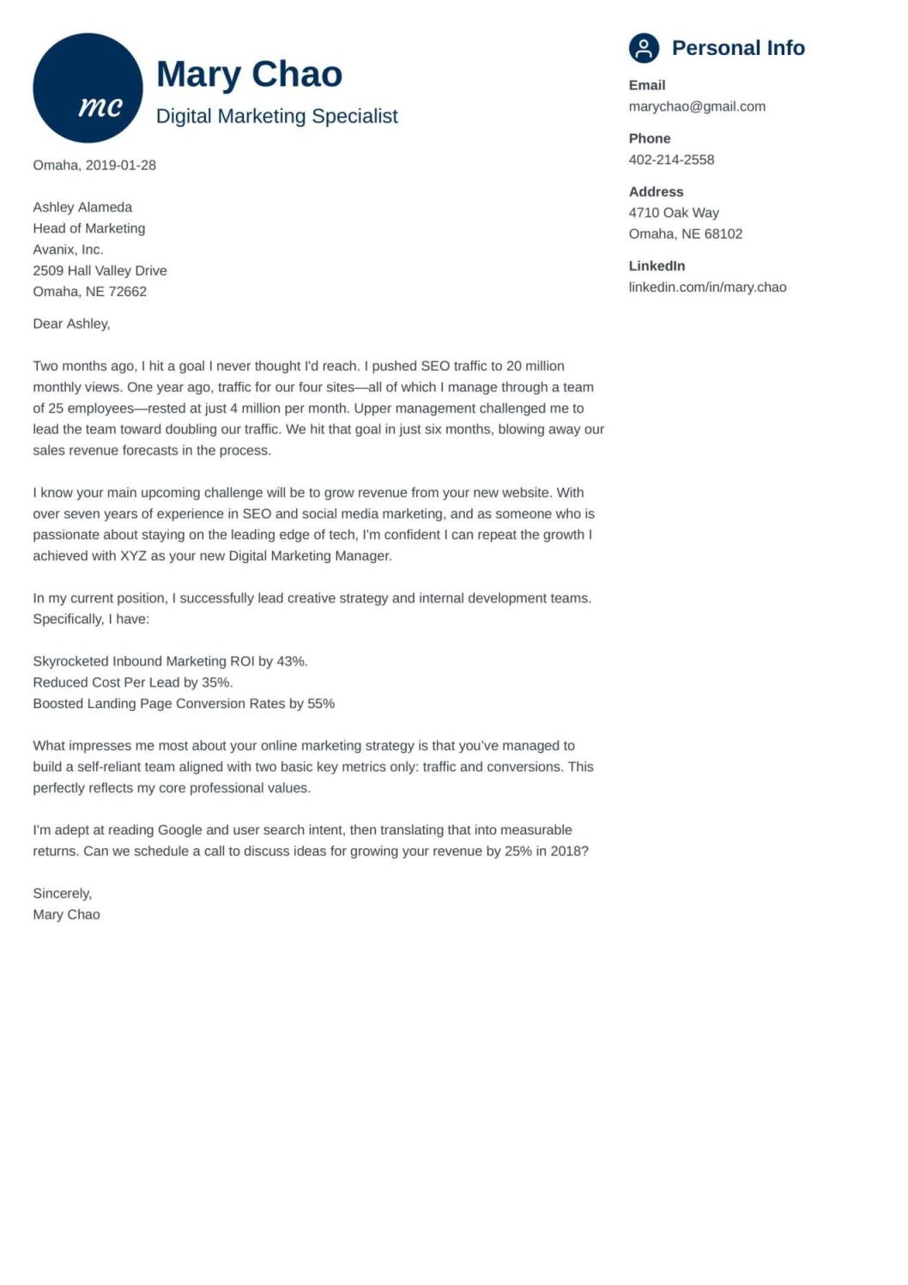
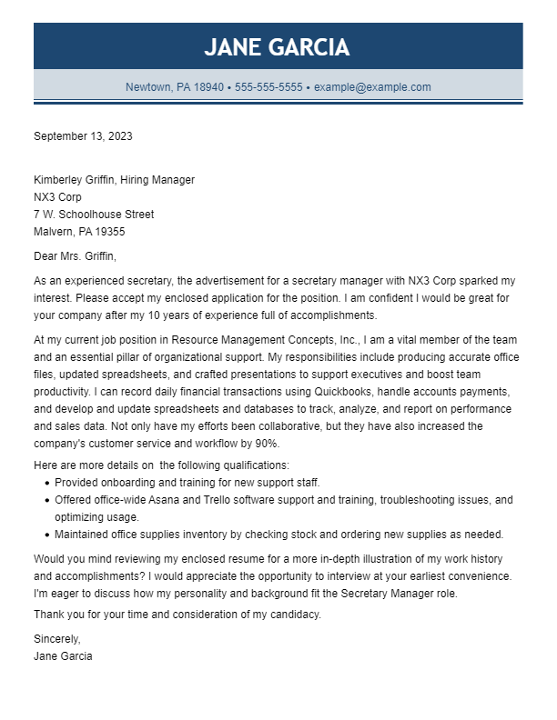
Sample Cover Letters

Slide 15
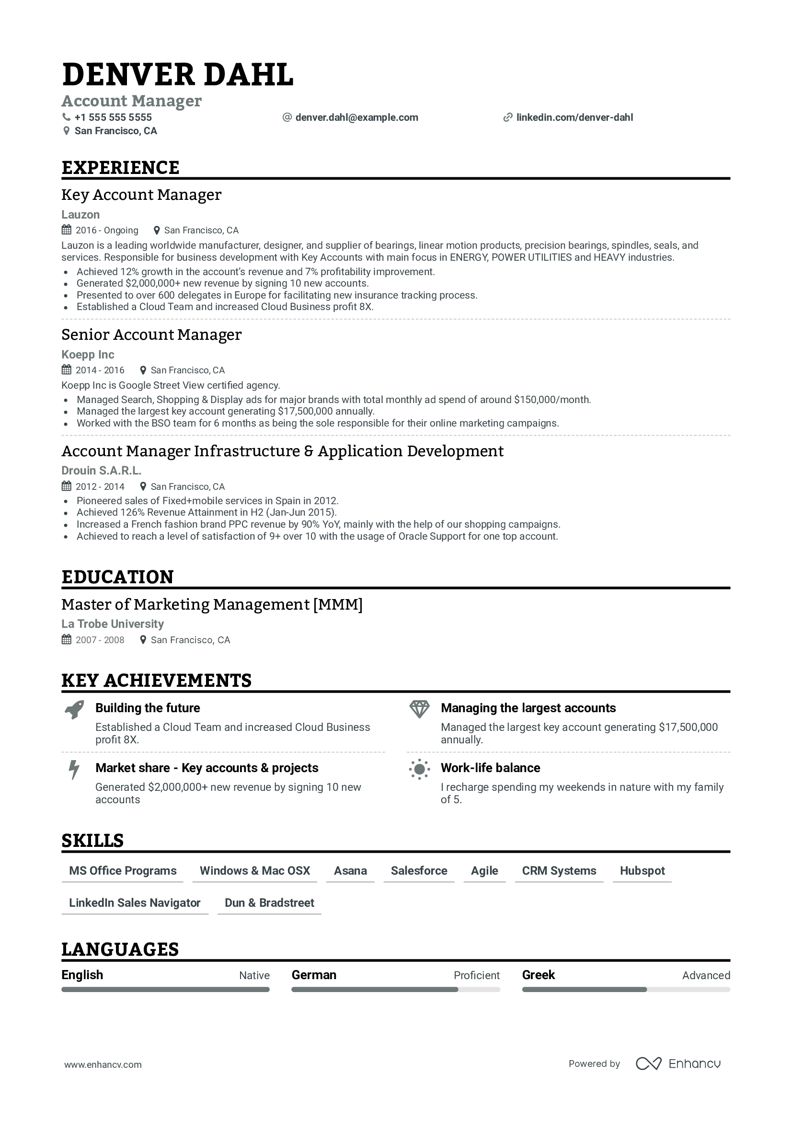
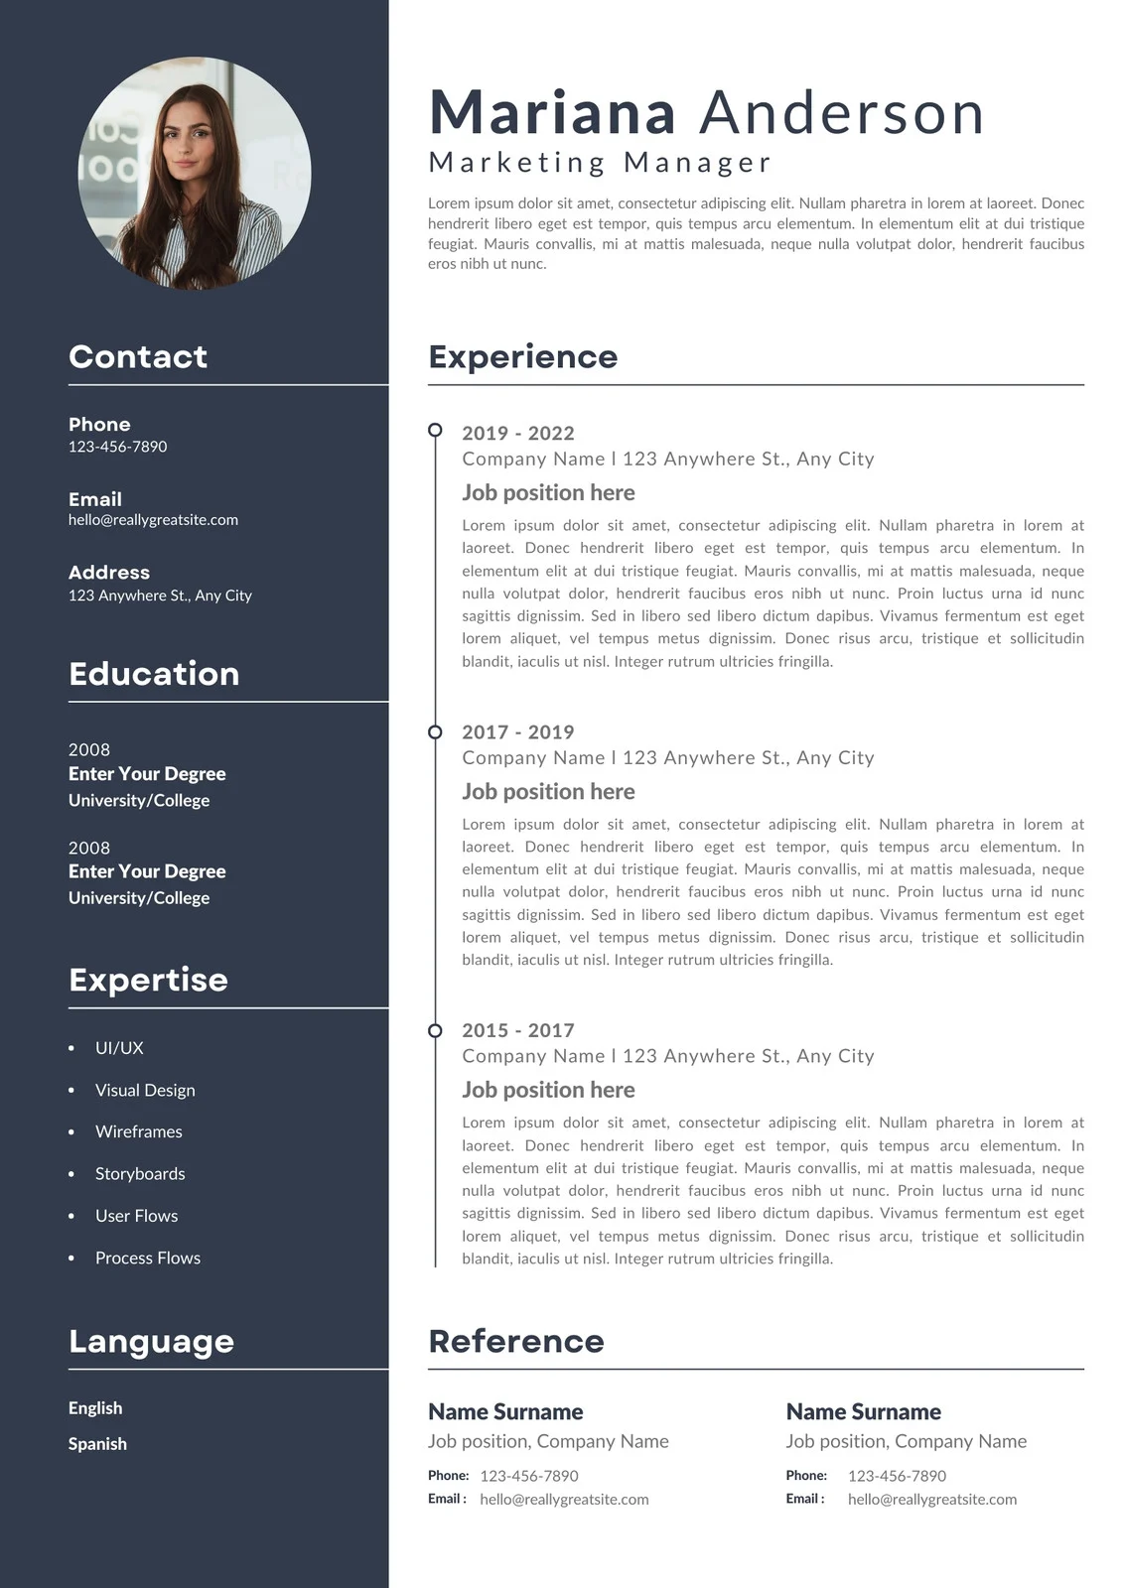
Sample Resume

